Slide 1
INFO215: Week 2b Sociotechnical Approaches: Key Ideas

Slide 2

https://www.youtube.com/watch?v=LUSZfEBTwRc
https://learn.dcollege.net/bbcswebdav/pid-12169965-dt-content-rid-237904932_1/xid-237904932_1

Slide 3
Bowker (1996)
Why did I ask you to read about the International Classification of Diseases?

Slide 4
Bowker (1996)
“The ICD is a complex information processing tool. As such it is at any one time associated both with a theory of historical knowledge and a particular configuration of technology. It is associated with a theory of historical knowledge in the sense that it embodies an understanding of what information about the past can and should be retained” (p.55).

Slide 5
Bowker (1996)
“The ICD is at each point associated with a particular configuration of technology. Like much modern technology it bears traces of its past. Computer screens tend to be 80 characters wide, an echo of the 80 columns of the preceding punch-card technology. […] Similarly the ICD bears traces of its technological base. For a long time it remained restricted to 200 headings: the number of lines that could fit on a standard folio sheet used by census offices” (p.56)

Slide 6
Bowker (1996)
“[…] one might say that typically an historian seeks to examine the change in an historical entity over time – a person as she or he gets older, a state as it goes to war, an idea as it is born, developed and superseded. In these standard cases one assumes – rightly or wrongly – that what it is to be a person a state or an idea does not change in the course of the historical treatment; in other words that there is a passive backdrop against which the historical drama is played out. Information infrastructures are constitutive of that backdrop; when they are foregrounded the historian's standard categories are rendered contingent, they become objects of historical examination” (p. 59).

Slide 7
Bowker (1996)
What is an information infrastructure?
What are the five properties of infrastructure?

Slide 8
Wong et al
What is Infrastructural Speculation?
Why does it matter?
What did you take away from this reading?

Slide 9
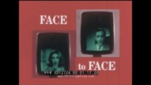

Slide 10
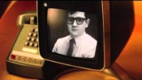

https://www.youtube.com/watch?v=WzdCKBZP4Jo

Slide 11
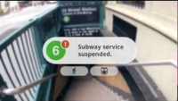

Slide 12


Slide 13
How does the “Stories” Glasses Relate to the readings?
https://www.youtube.com/watch?v=4Z1XYM7bC4k

Slide 14


Slide 15
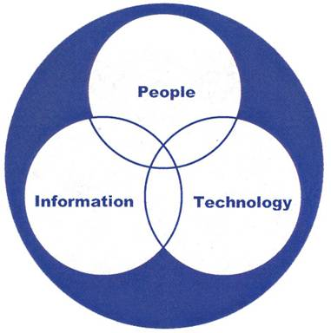
Some key sociotechnical ideas
Adoption curves
Hype cycles
Unintended consequences
Productivity paradoxes
Technopanics
Utopias and dystopias (to be discussed in a future class session)

Slide 16
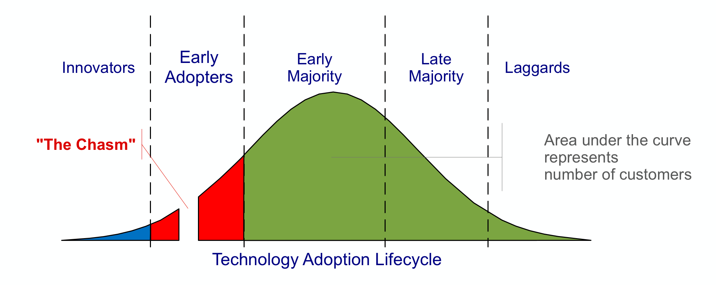
Adoption Curves (1957) and Chasms (1991)
Moore, G. (2014). Crossing The Chasm. Harper Business Essentials
Notes:
Chasm = a gap between the first two adopter groups (innovators/early adopters), and the vertical markets

Slide 17
Discussion
What were the adoption “chasms” for the picture phone?
How could its design have been improved?

Slide 18
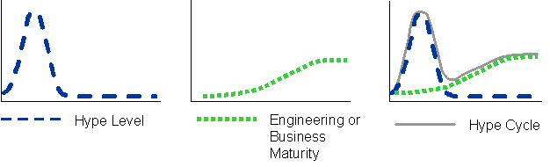
Hype Cycle (Gartner, 1995)

Slide 19
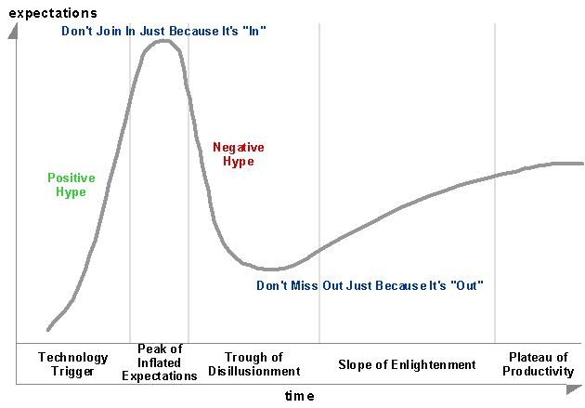

Slide 20
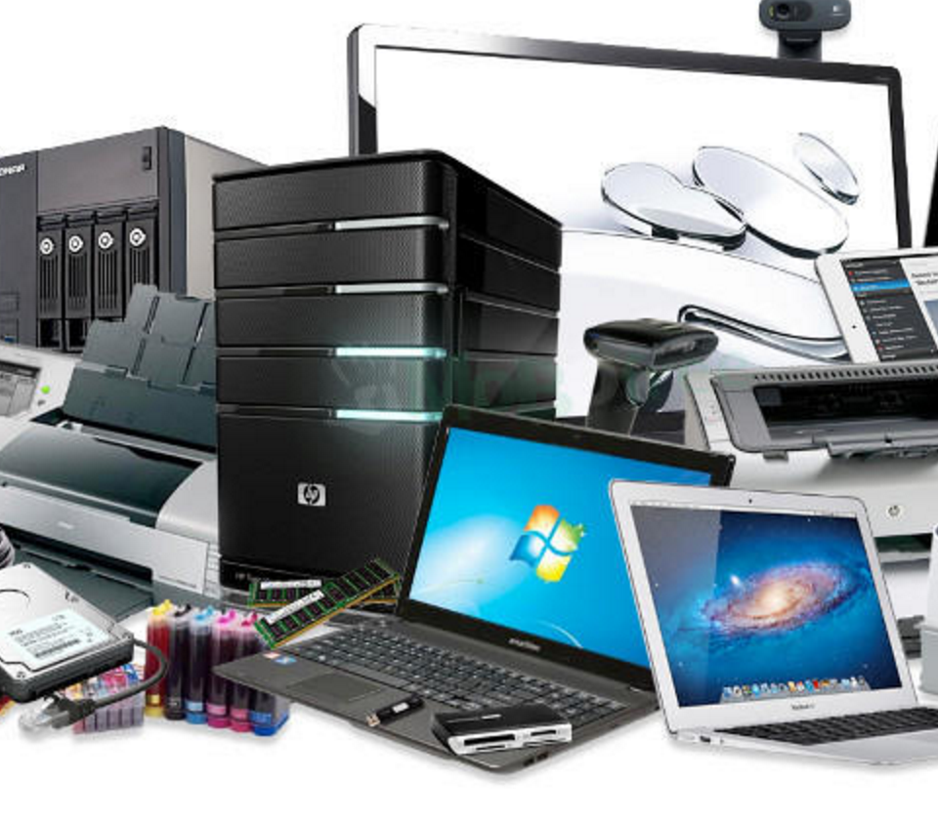
The Technology Obsolescence Chain: Planned Obsolescence
https://www.youtube.com/watch?v=4Z1XYM7bC4k
(stop at 6:90)

Slide 21
The Technology Obsolescence Chain: Perceived Obsolescence
https://youtu.be/N2KLyYKJGk0?t=74

Slide 22
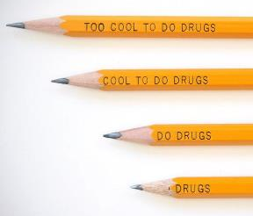
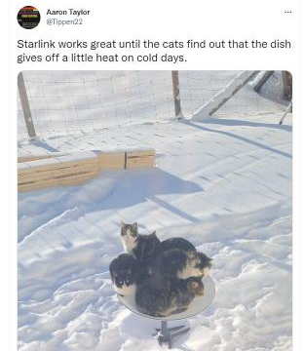

Unintended Consequences/Uses of Technology and Design
Unintended consequences and uses can be desirable or undesirable. Other examples?

Slide 23



Mobile devices have led to new behaviors that affect others and that necessitate new policies and legislation.
http://mrticketsd.com/fight-traffic-tickets-in-san-diego-ca/cell-phone-tickets-california/

Slide 24
Productivity Paradox (“The Solow Computer Paradox)
Apparent failure of computer/IT investment to produce productivity gains
“You can see the productivity age everywhere but in the productivity statistics” – Robert Solow, 1987
In the 1970s and 1980s, computing power exploded (~10,000%), yet industrial productivity slowed from 3% to 1%.
QUESTION: Why on earth did this happen?!?

Slide 25
Understanding the Productivity Paradox
https://www.wnyc.org/story/understanding-the-productivity-paradox/

Slide 26
Productivity Paradox (“The Solow Computer Paradox”)
Main causes:
Poor implementation
Systems did not support work practices.
Underestimation of amount of work required to extract value from new systems.

Slide 27

Technopanics (Marwick, 2008)
(1) focus on new media forms
(2) pathologize young people’s use of the media
(3) result in an attempt to modify or regulate young people’s behavior
Marwick A (2008) To catch a predator? The MySpace moral panic. First Monday, Available at: http://journals.uic.edu/ojs/index.php/fm/article/view/2152/1966
This image always makes me laugh.

Slide 28
Technopanics (Marwick, 2008)
Think of an information medium or platform that is popular with young people.
Consider each of the three parts of the theory of technopanics. Does each part apply to the medium or platform that you chose? Why or why not?
-------------------------
(1) focus on new media forms
(2) pathologize young people’s use of the media
(3) result in an attempt to modify or regulate young people’s behavior
Marwick A (2008) To catch a predator? The MySpace moral panic. First Monday, Available at: http://journals.uic.edu/ojs/index.php/fm/article/view/2152/1966

